Slide 1
Digital Portfolio
STUDENT NAME: U.KEERTHANA
REGISTER NO:36324U18024
NMID: E5F936966E604CE878442EE676B3AA1B
DEPARTMENT: BSC(COMPUTER SCIENCE)
COLLEGE: SREE ABIRAAMI ART & SCIENCE COLLEGE FOR WOMEN
THIRUVALUR UNIVERSITY

Slide 2
PROJECT TITLE
FORNT END WEB DEVELOPMENT

Slide 3

AGENDA
Problem Statement
Project Overview
End Users
Tools and Technologies
Portfolio design and Layout
Features and Functionality
Results and Screenshots
Conclusion
Github Link
3/21/2024 Annual Review

Slide 4

PROBLEM STATEMENT
Many users struggle with inefficient, outdated systems that lack user-centric design and real-time functionality. This project addresses the need for an intuitive, responsive, and scalable solution that enhances user experience, boosts productivity, and solves specific operational challenges.

Slide 5

PROJECT OVERVIEW
This project delivers a user-focused solution designed to address specific inefficiencies. It combines modern design, functionality, and scalability to improve usability, streamline processes, and enhance overall performance for individuals or organizations facing real-world digital challenges.

Slide 6
WHO ARE THE END USERS?
The end users are individuals or organizations who require efficient, intuitive, and reliable digital solutions. They seek improved user experience, streamlined workflows, and accessible interfaces tailored to their specific needs in personal, professional, or operational contexts.

Slide 7

TOOLS AND TECHNIQUES
This project utilized modern tools and techniques including [e.g., Figma, HTML, CSS, JavaScript, Python] for design and. wireframing, prototyping, and user testing were applied to ensure an efficient, user-friendly, and scalable end product.

Slide 8
POTFOLIO DESIGN AND LAYOUT
The portfolio features a clean, modern design with intuitive navigation to showcase projects effectively. It uses a balanced color scheme and clear typography for readability. Responsive layouts ensure seamless viewing across devices. Visual hierarchy and consistent spacing highlight key information, enhancing user engagement and providing a professional, organized presentation of skills and work
8

Slide 9
FEATURES AND FUNCTIONALITY
The portfolio includes a responsive design, easy navigation, and interactive elements to enhance user experience. Key features include project galleries, detailed case studies, and contact forms. Functionality focuses on fast loading times, mobile compatibility, and seamless integration with social media, ensuring accessibility and engagement for potential clients or employers across all devices.

Slide 10

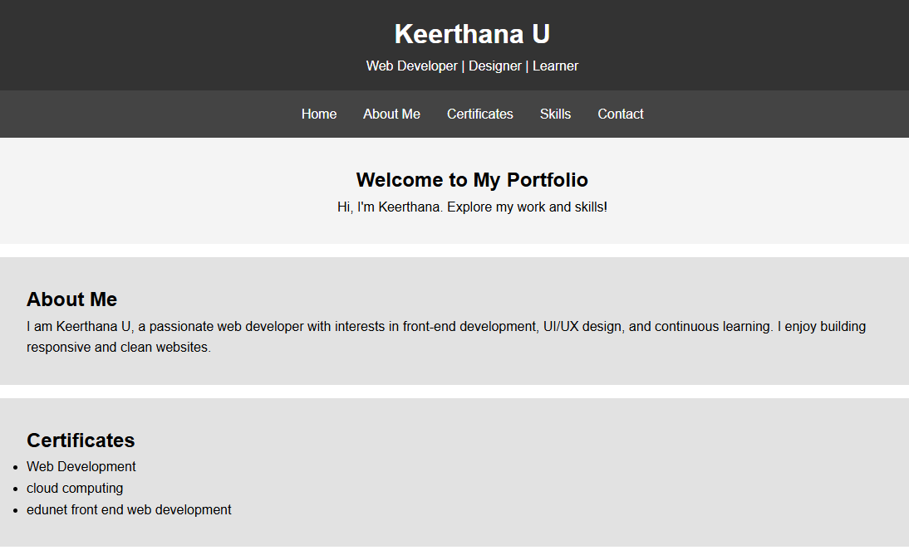
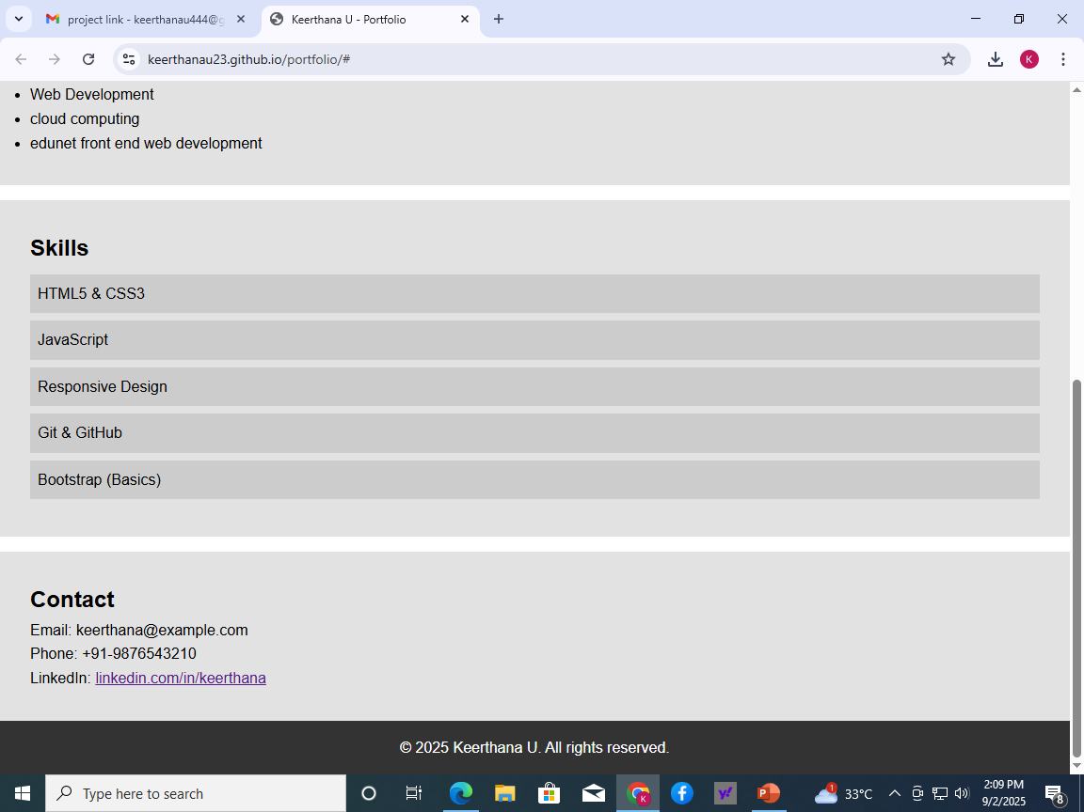
RESULTS AND SCREENSHOTS

Slide 11
CONCLUSION
This portfolio showcases Keerthana U’s skills, creativity, and dedication to delivering impactful solutions. Through diverse projects and innovative approaches, Keerthana demonstrates a strong commitment to quality and user-centric design. This collection reflects growth, professionalism, and readiness to contribute effectively to future challenges and opportunities in the industry.
11

Slide 12
GITHUB LINK
GITHUB LINK : keerthanau23/portfolio
PROJECT RESUME LINK : https://keerthanau23.github.io/portfolio/
GITHUB LINK : keerthanau23/portfolio

